Slide 1
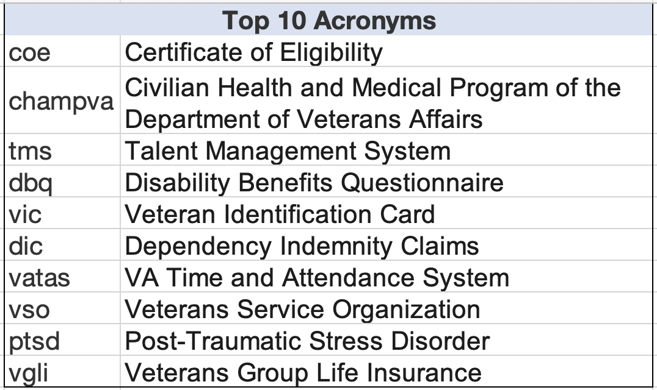
Acronym Audit
Search & Discovery
Purpose: Examine the frequency at which VA.gov users are searching for acronyms.
How frequently are acronyms appearing in queries?
Overall, 85 acronyms found in top 1000 query terms, representing 8.5% of all query terms.
How frequently are users searching for acronyms?
Acronym Queries represent 9.64% of all queries
Acronym Queries = 280,391
Total Queries = 2,907,384
When users search for an acronym are they finding relevant content ?
Overall CTR = 8.64% (low)
What are the top acronyms users are searching for?
Represent 4.6% of all queries.
Insights:
[From March 2020 Data]
Findability:
Total Queries: 646,959 ⬆️
(Feb – 559,914 Queries)
Service Completion:
Click Thru Rate: 33.71% ⬇️
(Feb – 34.44%)
Top 10 Queries
Customer Satisfaction:
Zero Result Searches 7 ⬆️
(Feb –3 query)

